Slide 1
Data Analytics and Visualization
Module - 01
Introduction to Data Analytics: Data Analytics: Definition, importance, and applications in industry; Types of analytics: descriptive, diagnostic, predictive, prescriptive; Data analytics lifecycle: problem definition, data collection, analysis, deployment; Types of data: structured, semi-structured, unstructured; Time Series Data; Data sources and formats; Python for data analytics: NumPy, Pandas, reading CSV/JSON files, indexing, filtering, grouping and aggregation; Overview of Big Data: characteristics (5Vs), ecosystem and tools.

Slide 2
Introduction to Data Analytics:
What is Data Analytics?
“Suppose you are the owner of a supermarket. You have sales data for the last 1 year. What can you do with this data?”
From the sales data, we can find:
Find which product sells the most
Find which month has more sales
Find which products are not selling
Find which customers buy more
Decide how much stock to purchase
“All these activities involve looking at data, finding useful information from it, and using that information to make better decisions. This process is called Data Analytics.”

Slide 3
Definition of Data Analytics:
Data Analytics is the process of collecting, cleaning, analyzing, and interpreting data to find useful information and support better decision-making.
(OR)
Data Analytics = Looking at data to understand what is happening and make better decisions.
Example:
Suppose a college has student attendance data:
Student | Attendance
A | 92%
B | 85%
C | 62%
D | 95%
E | 58%

Slide 4
We can analyze this data to answer:
Who has low attendance?
What is the average attendance?
How many students have less than 75% attendance?
Which class has the highest attendance?
Is attendance improving or decreasing?
The raw attendance numbers themselves are data.
After analyzing them, we obtain useful information.
For example:
“30% of students have attendance below 75%.” This statement is no longer just raw data.
That is an insight obtained from data.

Slide 5
Data vs Information vs Insight
This is an important concept :
1. Data
Data is raw facts and values that are collected.
Example:
85, 72, 91, 65, 55, 88, 92
By themselves, these numbers don't tell us much.
2. Information
When we organize and process the data, we get information.
For example:
Average attendance = 78%
Now the numbers have meaning.
3. Insight
An insight is a useful conclusion obtained from analyzing information.
For example:
“Students whose attendance is below 70% are more likely to have difficulty completing laboratory work.”
This insight can help the college take action.
Note:
Data = What we have
Information = What the data tells us
Insight = What we understand from it

Slide 6
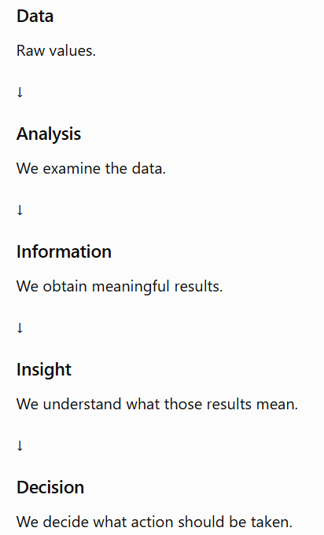
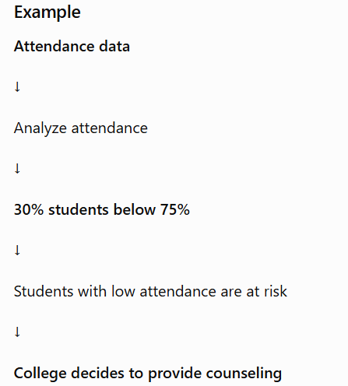
Simple flow is :
Data → Analysis → Information → Insight → Decision
“The ultimate purpose of Data Analytics is not just to calculate numbers. It is to use those numbers to make better decisions.”

Slide 7
Why Do We Need Data Analytics?
“Suppose our college has the attendance and marks of 5,000 students. Is simply storing all this data useful?” – Yes
“Can the college easily look at 5,000 students one by one and identify which students are having attendance problems?” – No
“This is where Data Analytics becomes important. We use analytics to examine large amounts of data, find useful patterns, identify problems, and make better decisions.”
Main Idea:

Slide 8
Organizations Generate Data Every Day
Almost everything we do today creates data.
For example, when you:
Use Google
Make a UPI payment
Order food
Watch YouTube
Buy something online
Use Instagram
Book a ticket
Attend an online class
Use a banking application some form of data is generated.
So, we can say:
Modern organizations are data-rich.
But being data-rich does not automatically mean being information-rich.
They need analytics to convert the data into useful information.
For example, when you make a UPI payment:
The system may record:
Amount
Date
Time
Sender
Receiver
Transaction status
All this becomes data.
Modern organizations are data-rich, but being data-rich does not automatically mean being information-rich.
Having 1 crore records doesn't mean we understand those records.
We need analytics to convert data into useful information.

Slide 9
College Example
A college may have 5,000 students.
Every semester, the college generates a huge amount of data.
Student data
Student ID
Name
Department
Semester
Attendance
IA marks
Assignment marks
Lab marks
End-semester marks
So, the college database can contain thousands of records.
Next question is “What can we do with this data?”

Slide 10
What happens if we only store the data?
Suppose the college has this:
Student | Attendance | IA Marks | Final Marks
Ravi | 92% | 82 | 88
Priya | 85% | 78 | 81
Arun | 62% | 45 | 51
Sneha | 95% | 90 | 94
Kiran | 58% | 40 | 46
This table is raw data.
The college may want to know:
How many students have attendance below 75%?
Which students are at academic risk?
Which subject has the lowest average marks?
Which department has the highest pass percentage?
Is attendance related to academic performance?
Which students need additional support?
Simply storing the data doesn't answer these questions.
Analysis is required.

Slide 11
Data Analytics Converts Data Into Information
Suppose we analyze the attendance data.
We find:
25% of students have attendance below 75%.
Now we have useful information.
We analyze marks and discover:
Students with low attendance generally have lower average marks.
Now we have an insight.
The college can then take action:
Provide academic counseling and additional support to students with low attendance.

Slide 12
So, the flow is:
Raw Data
↓
Data Analytics
↓
Information
↓
Insight
↓
Decision
↓
Action

Slide 13
2. Example: Bank
Every day, a bank may process millions of transactions.
For example:
₹500 UPI payment
₹2,000 ATM withdrawal
₹1,500 online purchase
₹20,000 bank transfer
₹50,000 cash withdrawal
All these transactions generate data. But the bank doesn't just want to store them.
The bank wants to know:
Which customers are actively using the bank?
Which customers are not using their accounts?
Which transactions are unusual?
Which customers may be likely to take a loan?
Are there suspicious transactions?
Which services are most popular?
Data Analytics helps answer these questions. Where, Analytics helps banks understand transaction data and customer behavior

Slide 14
3.Fraud Detection Example
Suppose a customer's normal transactions look like this:
₹500
₹1,000
₹2,500
₹800
₹1,500 Suddenly: ₹5,00,000 is transferred from the account. “Is this transaction automatically fraud?”
The bank's analytics system can identify that this transaction is very different from the customer's usual behavior. It can flag it for further investigation.
So:
Transaction Data
↓
Analytics
↓
Unusual Pattern Detected
↓
Possible Fraud
↓
Bank Investigates
This is one reason Data Analytics is extremely important in banking.

Slide 15
4. E-Commerce Example
Now take an online shopping website.
Every time you use an e-commerce application, many activities generate data.
For example:
You search for:
“Laptop”
Then you:
View a laptop.
Compare two laptops.
Add one to cart.
Remove it.
Search for another laptop.
Finally purchase one.
Every action generates data.
For example:
What did you search?
Which product did you view?
How long did you view it?
Did you add it to cart?
Did you purchase it?
“Do you think Amazon/Flipkart only stores your purchase?”
No.
There are many activities before the purchase.
Those activities generate useful data.

Slide 16
Why Is This E-Commerce Data Useful?
The company can analyze this data to understand:
Customer behavior
What products are customers interested in?
Product popularity
Which products are searched most frequently?
Purchasing behavior
Which products are actually purchased?
Customer preferences
What type of products does a particular customer prefer?
Problems
Why are customers adding products to the cart but not purchasing them?
These insights can help the company improve its business.
“The company is not just collecting customer activity. It is analyzing that activity to understand customers and improve the business.”

Slide 17
Importance of Data Analytics
There are several reasons why Data Analytics is important.
1. Better Decision-Making
Data Analytics helps organizations make decisions based on evidence rather than guesswork.
Example
Suppose a restaurant wants to decide which food items to promote.
Without analytics:
“I think pizza is the most popular.”
With analytics:
Now the restaurant has evidence.
The restaurant can clearly see that pizza has the highest sales.
So, it may decide to:
Promote pizza
Keep more pizza ingredients
Introduce new pizza varieties
Data Analytics helps us replace “I think” with “Data shows.”
Item | Monthly Sales
Pizza | 1,200
Burger | 800
Pasta | 500
Sandwich | 300

Slide 18
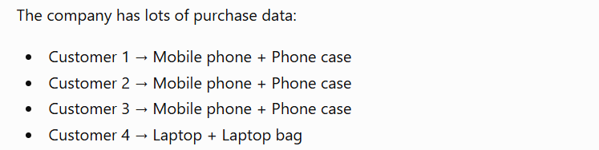
2. Identifying Trends and Patterns
Data Analytics helps us identify patterns that may not be obvious by simply looking at raw data.
Example: Online shopping
Suppose an e-commerce company analyzes purchases.
It discovers:
Customers frequently buy mobile phones together with phone cases.
This is a pattern.
The company can then recommend:
“Customers who bought this phone also bought this phone case.”
This is an example of analytics being used in recommendation systems.

Slide 19
3. Understanding Customers
Companies want to understand:
What customers like
What they dislike
What they purchase
How often they purchase
Why they stop using a product
Example
A streaming platform analyzes what users watch.
Suppose a user frequently watches:
Action movies
Thriller movies
Crime series
The system can recommend similar content.
So, “Analytics helps companies understand what customers are interested in and provide personalized services.”

Slide 20
4. Improving Business Performance
Analytics can identify areas where an organization is performing well and areas that need improvement.
Example
Suppose a company has five branches:
Branch | Sales
Bangalore | ₹20 lakh
Mysore | ₹15 lakh
Chennai | ₹25 lakh
Hyderabad | ₹18 lakh
Pune | ₹10 lakh
The company can investigate:
Why is Pune's performance lower?
Maybe:
Less advertising
Fewer customers
Higher prices
Poor location
Less product availability
“Analytics helps us identify not only WHAT is happening, but also helps us investigate WHY it is happening.”

Slide 21
5. Predicting Future Outcomes
Data Analytics can also help organizations predict what may happen in the future.
For example, a company may analyze previous sales:
2023 → ₹10 lakh
2024 → ₹13 lakh
2025 → ₹17 lakh
Based on historical patterns, the company can estimate future sales.
This is called predictive analytics.
“We use past data to understand the present and sometimes predict what may happen in the future.”

Slide 22
6. Detecting Fraud
Data Analytics is heavily used by banks and financial institutions.
Example
Suppose a person's normal transactions are:
₹500
₹1,200
₹800
₹2,000
Suddenly, there is a transaction:
₹5,00,000 from a different location.
An analytics system can identify this as unusual behavior and flag the transaction.
This can help detect:
Credit card fraud
Banking fraud
Suspicious transactions
Account misuse
“The important point is that analytics can learn or identify normal transaction behavior and highlight unusual patterns.”

Slide 23
7. Reducing Costs
Analytics can help organizations identify unnecessary expenses.
Example
A manufacturing company analyzes electricity usage.
It discovers that one machine consumes significantly more electricity than others.
The company can investigate:
Is the machine old or inefficient?
Does it require maintenance?
Can operating time be reduced?
If the company identifies and fixes the problem, it can reduce electricity consumption and operational costs.
“Analytics helps organizations find where money or resources are being unnecessarily spent.”

Slide 24
Applications of Data Analytics in Industries
1. Healthcare
“In hospitals, a lot of data is generated about patients, treatments, medicines, test results, etc.”
Data Analytics can help hospitals:
Understand patient records
Identify diseases and risks
Analyze treatment results
Manage hospital resources
Simple example:
“Suppose a hospital analyzes patient data and finds that many patients have a particular disease during a particular season. The hospital can prepare medicines, doctors and beds in advance.”
So: Healthcare → Patient data → Analysis → Better healthcare decisions

Slide 25
2. Banking and Finance
“Banks handle thousands or millions of transactions every day. Data Analytics helps banks understand these transactions.”
It can be used for:
Detecting unusual transactions
Understanding customer spending
Assessing loan applications
Managing financial risks
Example:
“Suppose a person's account normally has small transactions, but suddenly there is a very large unusual transaction. Data Analytics can help the bank identify this unusual behavior.”

Slide 26
3. Retail and E-Commerce
“Online shopping companies collect data about what customers search for, what they buy and what they don't buy.”
Data Analytics helps them:
Understand customer preferences
Recommend products
Identify popular products
Manage inventory
Plan discounts
Example:
“If many customers buy mobile phones along with phone cases, the company can recommend a phone case when someone buys a mobile.”

Slide 27
4. Education
“Schools and colleges also generate a lot of data.”
For example:
Marks
Attendance
Assignment scores
Exam results
Student performance
Data Analytics can help teachers:
“Suppose a teacher analyzes students' marks and notices that many students are performing poorly in one particular topic. The teacher can identify that topic and explain it again.”
So , analytics helps in understanding student performance and improving teaching.

Slide 28
5. Entertainment
“Streaming platforms such as Netflix and YouTube also use Data Analytics.”
They analyze:
What users watch
How long they watch
What they search for
What they skip
Then they can:
“Recommend movies, videos or shows that the user may like.”

Slide 29
Types of Data Analytics
What happened? → Descriptive Analytics
Why did it happen? → Diagnostic Analytics
What is likely to happen? → Predictive Analytics
What should we do? → Prescriptive Analytics

Slide 30
1. Descriptive Analytics (“Descriptive Analytics summarizes past and present data to tell us what happened.”) (OR)
Descriptive Analytics tells us what happened in the past or what is happening now.
It mainly answers:
“What happened?”
It takes existing data and summarizes it.
Restaurant example:
Suppose a restaurant has this monthly sales data:
Month | Sales
January | ₹50,000
February | ₹60,000
March | ₹45,000
April | ₹70,000
The restaurant analyzes this data.
It can say:
“Sales were ₹50,000 in January, ₹60,000 in February, ₹45,000 in March and ₹70,000 in April.”
This is Descriptive Analytics because we are simply describing what happened.

Slide 31
Real-life examples
Descriptive Analytics can answer:
How many products were sold?
What was the total revenue?
How many students passed?
How many customers visited the website?
What were the sales last month?

Slide 32
2. Diagnostic Analytics
“Descriptive Analytics told us WHAT happened. But now we want to know WHY it happened.”
So Diagnostic Analytics answers:
“Why did it happen?”
Continue the same restaurant example
From our previous data:
Month | Sales
January | ₹50,000
February | ₹60,000
March | ₹45,000
April | ₹70,000
The company analyzes other data and discovers:
There was heavy rain.
Fewer customers visited the restaurant.
One popular food item was unavailable.
There were fewer promotional offers.
Now the company understands the reason for the low sales.
That is Diagnostic Analytics.
We already know that:
March had the lowest sales.
That's descriptive analytics.
Now the restaurant asks:
“Why were sales low in March?”

Slide 33
Real-life example
Suppose a college notices:
“Student attendance decreased in August.”
That's descriptive.
Then the college investigates and discovers:
“Attendance decreased because many students were absent during a festival period.”
That's diagnostic.

Slide 34
3. Predictive Analytics
“So far, we looked at the past. First , we asked WHAT happened, then WHY it happened. Now we want to look toward the future.”
Predictive Analytics answers:
“What is likely to happen in the future?”
It uses past and current data to make predictions about the future.
Continue our restaurant example
Suppose the restaurant has analyzed several years of sales data.
It notices:
“Whenever summer starts, cold drinks and ice creams sell much more.”
Now summer is approaching.
The restaurant may predict:
“Cold drink sales are likely to increase next month.”
This is Predictive Analytics.
Notice something important:
We are not saying it will definitely happen.
We are saying:
“Based on past data, this is likely to happen.”

Slide 35
Another example: Student marks
Suppose a college has data about students:
Attendance
Assignment marks
Internal exam marks
Previous exam performance
The college analyzes this data and predicts:
“Students with very low attendance and low internal marks may be at higher risk of failing the final exam.”
This is predictive analytics.
“Predictive Analytics uses past and current data to predict what is likely to happen in the future.”

Slide 36
4. Prescriptive Analytics
“We have now understood what happened, why it happened, and what may happen. But there is one more important question.”
Ask:
“If we know what is likely to happen, what should we do about it?”
This is Prescriptive Analytics.
It answers:
“What should we do?”
Continue the restaurant example
Predictive Analytics tells us:
“Cold drink sales are likely to increase next month.”
Now the restaurant has to decide:
“What should we do?”
Prescriptive Analytics may suggest:
Order more cold drinks.
Keep extra stock.
Give a discount on cold drinks.
Create a combo offer.
Increase advertising for cold drinks.
That is Prescriptive Analytics.

Slide 37
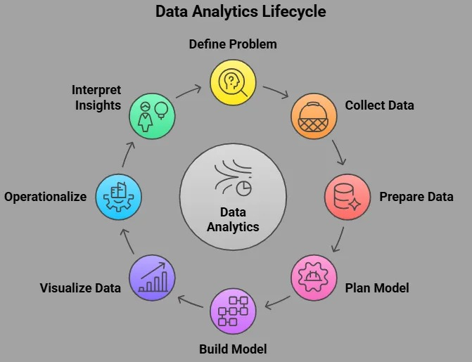
Data Analytics Lifecycle

Slide 38
1. Define the Problem Statement
First, we need to clearly understand what problem we want to solve.
We ask:
"What do we want to find out from the data?"
Example – College:
A college wants to know:
"Why are some students getting low marks?"
So, the problem statement is:
Identify the factors affecting students' academic performance.

Slide 39
2. Collect the Data
Once we know the problem, we need to collect the required data.
Data can come from:
College databases
Surveys
Excel files
Websites
Sensors
Applications
Social media
Example:
For student performance, we may collect:
Student | Attendance | Study Hours | Assignment Marks | Exam Marks
A | 90% | 5 | 85 | 88
B | 60% | 2 | 60 | 55
C | 80% | 4 | 75 | 78

Slide 40
3. Prepare the Data
The collected data may not be ready for analysis.
It can contain:
Missing values
Duplicate records
Incorrect values
Different formats
Unnecessary data
So ,we clean and prepare the data.
For example:
Attendance = 90%
but another record may have:
Attendance = "90 percent"
We need to convert them into a common format.
Simple meaning:
Prepare = Clean the data and make it ready for analysis

Slide 41
4. Plan the Model
Now we decide how we are going to analyze the data.
We decide:
What variables/features are important?
Which analytical method should we use?
What type of model is suitable?
What are we trying to predict or classify?
For example:
If we want to predict whether a student will pass or fail, we may choose a classification model such as:
Decision Tree / Logistic Regression / Random Forest
So:
Plan Model = Decide what method/model we should use.

Slide 42
5. Build the Model
Now we actually apply the selected model to the data.
For example:
We give the student data to a machine learning model.
Attendance
Study Hours
Assignment Marks
↓
ML Model
↓
Pass / Fail
The model learns patterns from the available data

Slide 43
6. Visualize the Data
Now we represent the results using graphs and charts so that they are easier to understand.
For example:
Bar chart
Histogram
Pie chart
Scatter plot
Box plot
Line chart
We might create a graph showing:
Attendance vs Exam Marks
This may help us visually see that students with higher attendance generally have higher marks.
So:
Visualization = Convert data/results into graphs so humans can understand them easily.

Slide 44
7. Interpret the Insights
This is where we ask:
"What does the result actually mean?"
Suppose our analysis shows:
Students with attendance above 80% generally score higher.
This is an insight.
We don't just look at the graph—we explain what the result tells us.
For example:
Insight:
"Attendance appears to have a positive relationship with academic performance."

Slide 45
8. Operationalize
Finally, we put the results into practical use.
The analysis should help someone take action or make a decision.
For example, the college may create an early-warning system:
Student attendance < 60%
↓
System identifies student
↓
Teacher receives notification
↓
Counselling / Support provided
So:
Operationalize = Take the analytics/model into the real world and use it for decision-making.

Slide 46
Types of Data
1. Structured Data
Structured data is data that is organized in a fixed format, usually in rows and columns.
Think about an Excel sheet.
Student ID | Name | Age | Marks
101 | Ravi | 20 | 85
102 | Priya | 21 | 90
103 | Arun | 20 | 78
Everything has a proper place:
Student ID → one column
Name → one column
Age → one column
Marks → one column
Examples
Excel tables
SQL databases
Student records
Bank transaction tables
Employee records

Slide 47
2. Semi-Structured Data
Semi-structured data does not follow a strict table format, but it still contains some organization using tags, keys, or metadata.
Common examples are:
JSON
XML
HTML
For example, JSON:
{
"name": "Ravi",
"age": 20,
"marks": 85
}
There are no rows and columns like an Excel table.
But we still know:
name → Ravi
age → 20
marks → 85
So, it has some structure, but not a fixed tabular structure.

Slide 48
3. Unstructured Data
Unstructured data is data that does not have a predefined structure.
Examples:
Images
Videos
Audio
Emails
Social media posts
PDF documents
Text documents
For example, consider a photograph:
📷 A photo does not have columns such as:
Name | Age | Marks
It is simply an image containing pixels.
Similarly:
🎵 An audio recording contains sound.
🎥 A video contains images, sound, etc.

Slide 49
4. Time-Series Data
Time-series data is data that is collected or recorded over time.
The important thing here is time.
For example, temperature recorded every hour:
Time | Temperature
9 AM | 25°C
10 AM | 27°C
11 AM | 29°C
12 PM | 31°C
Here, the data is connected to time.
Examples
Stock prices
Daily sales
Weather temperature
Monthly electricity usage
Website visitors per day
Sensor readings
Heart-rate readings over time
Time-series data = Data collected in chronological order over time.

Slide 50
Data Sources
"Where does this data come from?"
That is what we mean by data sources.
Data sources can be broadly divided into:
A. Internal Data Sources
Data generated inside an organization.
Examples:
Company database
Sales records
Employee records
Customer records
Attendance system
Transaction records
B. External Data Sources
Data obtained from outside the organization.
Examples:
Government websites
Social media
Public datasets
Weather services
Online websites
Research organizations

Slide 51
Common Data Sources
Data Source | Example
Database | MySQL, PostgreSQL
Files | Excel, CSV
Websites | Web data
APIs | Weather API
Sensors | Temperature sensor
Social Media | Posts, comments
Surveys | Google Forms
Applications | Mobile app data
Cloud | Cloud databases/storage

Slide 52
Data Formats
Now the next question is,
"How is data stored?"
The answer is data formats.
Some common formats are:
CSV
CSV = Comma-Separated Values
Example:
ID,Name,Marks
101,Ravi,85
102,Priya,90
103,Arun,78
Usually used for tabular/structured data.
Excel
Example:
Student.xlsx
Contains rows, columns, formulas, multiple sheets, etc.
Used commonly for structured data.
JSON
Example:
{
"name": "Ravi",
"age": 20,
"marks": 85
}
Commonly used for web applications and APIs.

Slide 53
XML
Example:
<student>
<name>Ravi</name>
<age>20</age>
<marks>85</marks>
</student>
Uses tags to organize information.
Text
Examples:
.txt
.docx
.pdf
Can contain written information such as reports, documents, and messages.
Audio
Examples:
.mp3
.wav
Contains sound.
Image
Examples:
.jpg
.png
.jpeg
Contains visual information.
Video
Examples:
.mp4
.avi
.mkv
Contains video information, often along with audio.

Slide 54
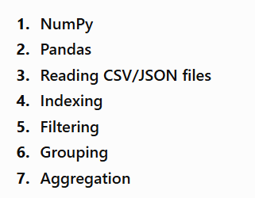
Python for data analytics: NumPy, Pandas, reading CSV/JSON files, indexing, filtering, grouping and aggregation.

Slide 55
"Suppose you are working as a Data Analyst in an e-commerce company. The company has a large amount of sales data. The management wants to know which products are selling well, which region has the highest sales, whether there are missing or duplicate records, and how sales information can be combined with product and regional information.“
"Today we will learn how Python can help us answer these business questions using NumPy and Pandas."

Slide 56
NUMPY
It stands for Numerical Python, NumPy helps us perform calculations on numerical data efficiently. (OR)
NumPy is a Python library used for efficient numerical computing and working with arrays.
NumPy
↓
Numerical Python
↓
Work with numerical data
Uses
NumPy is used for:
Creating numerical arrays
Mathematical calculations
Array operations
Statistical calculations
For example:
Sales = [50000, 5000, 8000, 12000]
Questions:
What is the total sales?
What is the average sales?
What is the highest sales?

Slide 57
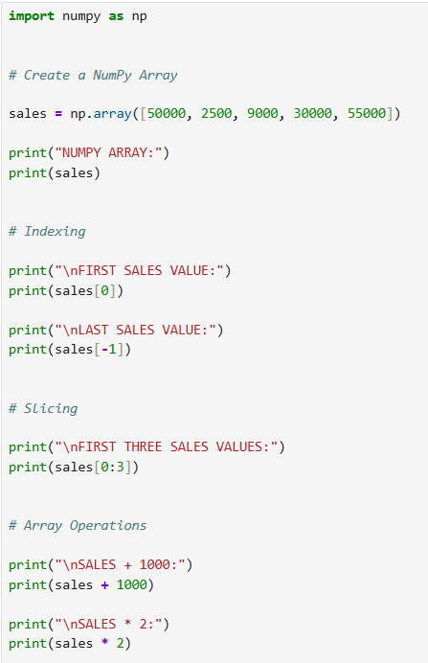
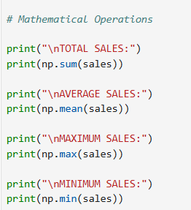
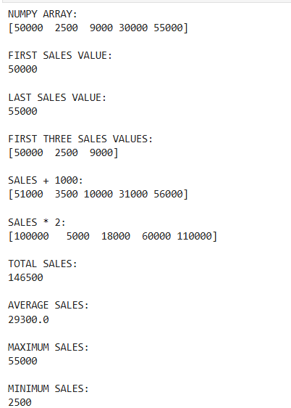
OUTPUT

Slide 58
"NumPy allows us to perform calculations on the entire array without writing a loop for every element."
Then transition:
"But our real sales data contains not only numbers. It contains product names, categories, regions, dates, sales and profit. For this type of tabular data, Pandas is more useful."

Slide 59
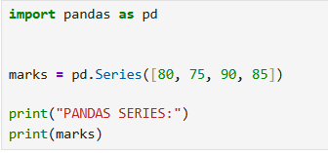
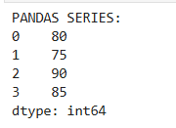
Pandas
Pandas is a Python library used to store, manipulate, analyze and visualize structured or tabular data.
Introduce two important structures:
Series
A single column of data. (or) "A Series is similar to one column in a table."
DataFrame
A complete table containing rows and columns.
Coding – Series

Slide 60
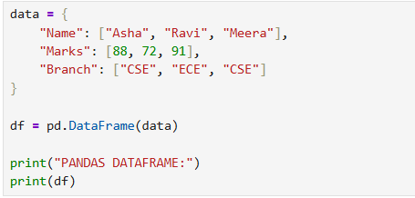
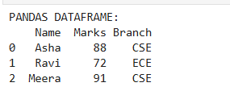
Coding – DataFrame
"A DataFrame is a two-dimensional table consisting of rows and columns."

Slide 61
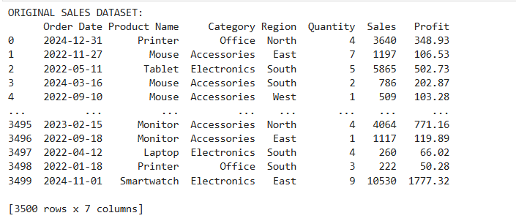
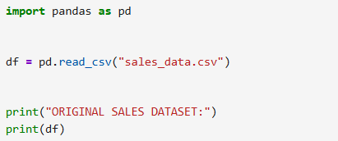
"Instead of creating our sales data manually, suppose the company gives us a CSV file."
Reading a Real CSV Dataset
CSV stands for Comma-Separated Values. It is one of the most commonly used formats for storing tabular data.
Pandas provides:
pd.read_csv() to read CSV files.

Slide 62
Reading JSON Files
JSON is another commonly used format for storing and exchanging data, especially between applications and APIs.
Coding
json_df = pd.read_json("sales_data.json")
print("JSON DATASET:")
print(json_df)
CSV → pd.read_csv()
JSON → pd.read_json()

Slide 63
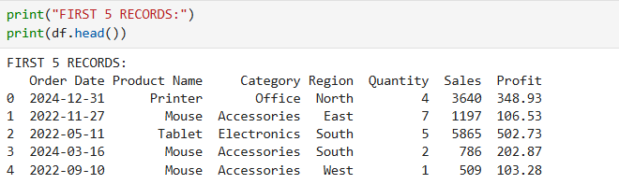
Understanding the Dataset
"After loading the data, a data analyst should never immediately start making conclusions. First, we need to understand the dataset."
1. First 5 Records
head() displays the first five rows by default.
"This gives us a quick look at what the dataset contains."

Slide 64
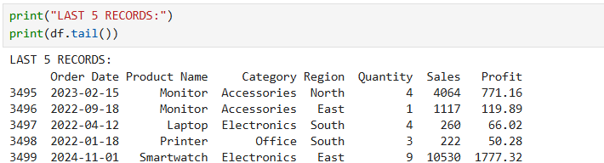
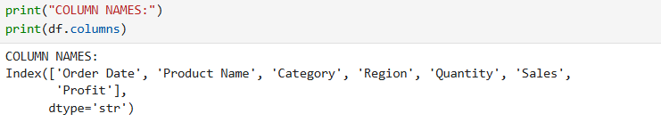

2. Last 5 Records
"tail() displays the last five records."
3. Dataset Shape
4. Column Names
"This tells us what information is available in our dataset."

Slide 65
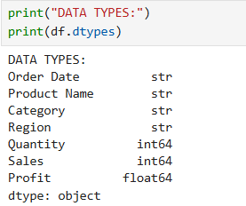
5. Data Types
"This tells us whether each column contains integers, decimal values, strings, dates, etc."

Slide 66
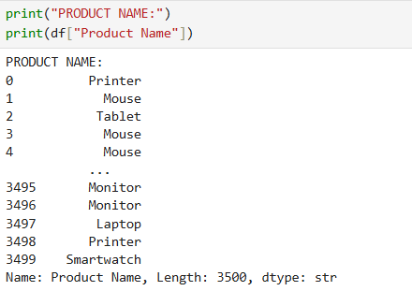
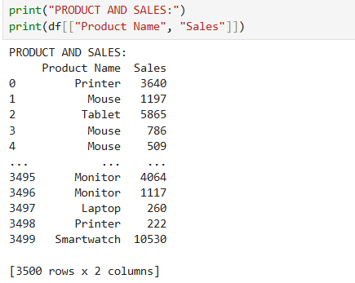
Indexing
Indexing means selecting specific rows, columns or values from a DataFrame.
"Suppose the manager doesn't want the entire dataset. She only wants the Product Name column."
Column Indexing
Multiple Columns
We can select more than one column by giving the column names inside a list."

Slide 67
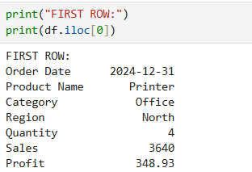

Row Indexing
"iloc selects data based on its numerical position."
Specific Value
"This gives the value located at that row and column position."

Slide 68
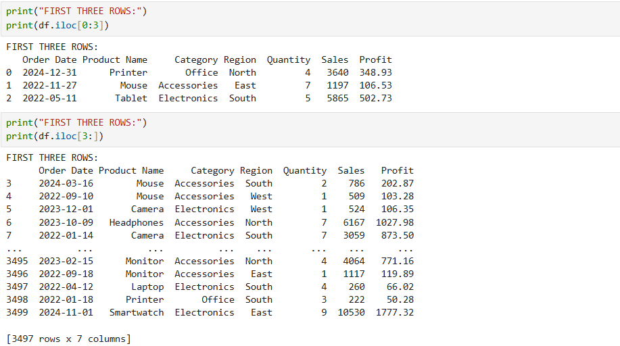
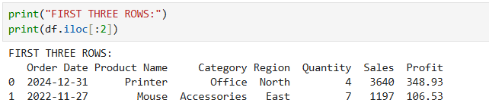
Slicing ( when you want to extract a group of elements)

Slide 69
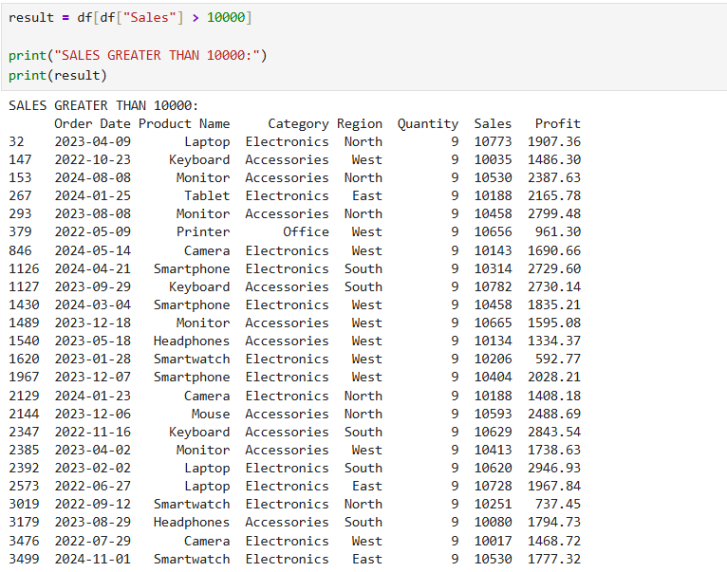
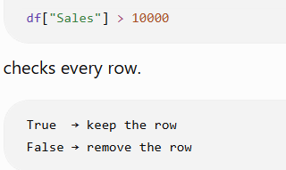
Filtering
"The manager wants to see only the transactions where sales are greater than ₹10,000."
Filtering means selecting only the rows that satisfy a particular condition.

Slide 70
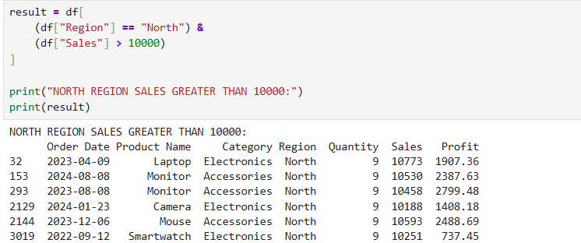
Multiple Conditions
"Show North region transactions where sales are greater than ₹10,000."

Slide 71
Exploratory Data Analysis
"Exploratory Data Analysis, or EDA, means examining and understanding the dataset before performing further analysis.“
EDA helps us:
Understand the data
Find patterns
Find missing values
Find duplicate records
Understand numerical values

Slide 72
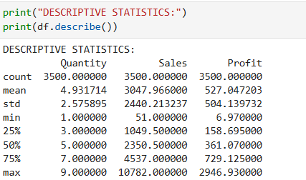
Descriptive Statistics
describe() gives statistical information such as:
Count
Mean
Standard deviation
Minimum
25%
50%
75%
Maximum
"This helps us understand the distribution of numerical columns such as Quantity, Sales and Profit."

Slide 73
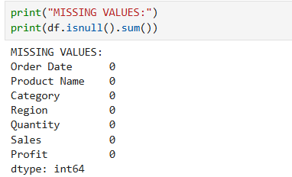
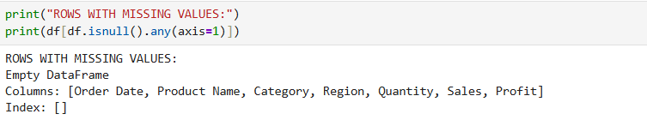
Missing Values
"isnull() checks whether a value is missing."
"sum() counts how many missing values are present in each column."
Display Rows With Missing Values
"This shows the complete records where at least one value is missing."

Slide 74
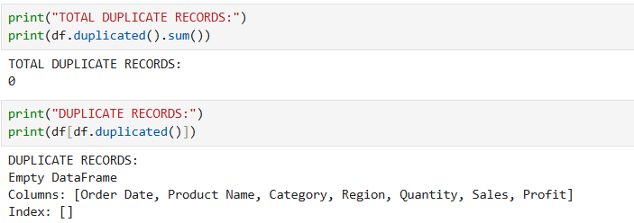
Duplicate Records
"duplicated() identifies repeated rows."
This displays the actual duplicate records.

Slide 75
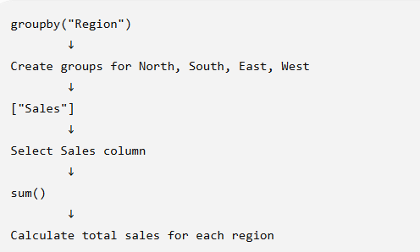
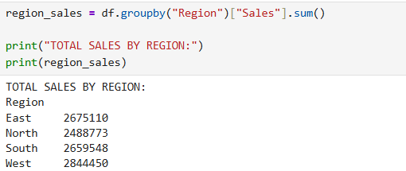
Grouping and Aggregation
"Suppose the manager doesn't want to see every transaction. She wants to know the total sales for each region.“
Grouping means dividing the data into groups based on a particular column.
Aggregation means performing a calculation such as sum, mean, maximum or minimum on each group.
Total Sales by Region

Slide 76
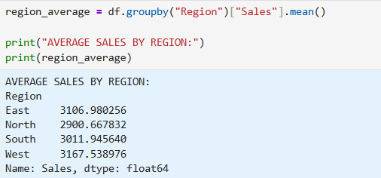
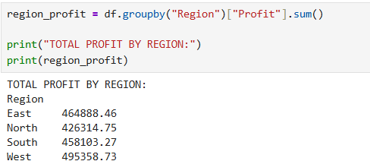
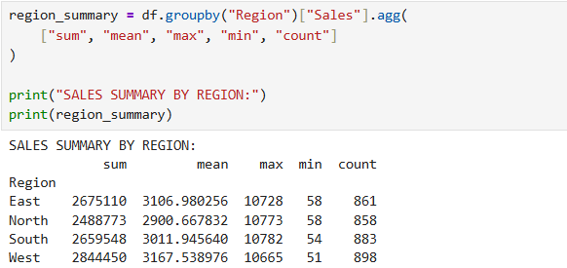
Average Sales by Region
Total Profit by Region
Multiple Aggregations Together

Slide 77
Overview of Big Data: characteristics (5Vs), ecosystem and tools
What is Big Data?
Big Data refers to extremely large and complex amounts of data that are difficult to store, process, and analyze using traditional data-processing systems. (OR)
“Big Data is not simply data that is big. It is data that is very large, generated very quickly, comes in different forms, may have quality problems, and can provide useful information when properly analyzed.”

Slide 78
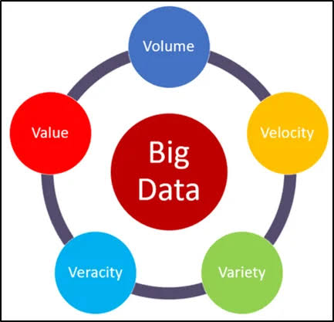
The 5Vs of Big Data (OR) Characteristics of Big Data — 5Vs
The five characteristics are:
Volume
Velocity
Variety
Veracity
Value

Slide 79
Volume
Volume refers to the enormous quantity of data generated, collected, and stored by organizations and digital systems.
Traditional databases are generally designed to handle relatively smaller amounts of data. Big Data environments are designed to handle data ranging from gigabytes (GB) to terabytes (TB), petabytes (PB), and beyond.
Sources of Large Data Volumes
Data can be generated from:
Social media platforms
E-commerce transactions
Banking systems
Websites and mobile applications
IoT devices
Sensors
Video and audio platforms
Business transactions
Machine and application logs

Slide 80
Example — E-Commerce
Consider an online shopping platform.
Every customer interaction generates data:
Customer Registration
↓
Product Search
↓
Product View
↓
Add to Cart
↓
Purchase
↓
Payment
↓
Product Review
When millions of customers perform these activities, the organization generates an enormous volume of data.
Volume answers the question: “How much data is being generated or stored?”

Slide 81
Velocity
Velocity refers to the speed at which data is generated, transmitted, collected, and processed.
In many modern applications, data is generated continuously and needs to be processed quickly or in real time.
Examples of High-Velocity Data
Online banking transactions
Stock market transactions
Social media activities
IoT sensor readings
GPS location updates
Website clicks
Online advertisements
Real-time monitoring systems

Slide 82
Example — Online Banking
Suppose thousands of customers perform transactions at the same time.
Customer A → ₹5,000 transaction
Customer B → ₹2,000 transaction
Customer C → ₹10,000 transaction
Customer D → ₹7,000 transaction
↓
Data generated continuously
↓
Banking system processes the transactions
The system must process this data quickly to:
Confirm transactions
Detect suspicious activity
Update account balances
Generate notifications

Slide 83
Variety
Variety refers to the different types, formats, and structures of data generated from various sources.
Unlike traditional systems that mainly work with structured tables, Big Data can contain structured, semi-structured, and unstructured data.
Types of Data
1. Structured Data
Data organized in a predefined format, usually rows and columns.
Example:
Customer_ID | Name | Age | Purchase
101 | Ravi | 25 | Laptop
102 | Anu | 28 | Mobile
Examples:
Relational databases
Spreadsheets
Transaction records

Slide 84
2. Semi-Structured Data
Data that does not follow a strict table structure but contains tags, keys, or other organizational elements.
Examples:
JSON
XML
HTML
Application logs
Example:
{
"customer_id": 101,
"product": "Laptop",
"price": 50000
}

Slide 85
3. Unstructured Data
Data that does not have a predefined data structure.
Examples:
Images
Videos
Audio
Emails
PDF documents
Social media posts
Text documents

Slide 86
Example — Social Media
A social media platform can receive:
Text
↓
"Great product!"
Image
↓
Product photograph
Video
↓
Product demonstration
Audio
↓
Voice message
Location
↓
GPS coordinates
All these represent different forms of data.
Variety answers the question: “What different types and formats of data are being generated?”

Slide 87
Veracity
Veracity refers to the quality, accuracy, consistency, reliability, and trustworthiness of data.
Big Data can contain large amounts of inaccurate, incomplete, duplicated, or inconsistent information.
Therefore, organizations need to evaluate and clean data before using it for analysis and decision-making.
Common Data Quality Problems
Big Data may contain:
Missing values
Incorrect values
Duplicate records
Inconsistent information
Outdated information
Fake information
Noisy data
Veracity answers the question: “How accurate, reliable, and trustworthy is the data?”

Slide 88
Example — Customer Data
Suppose a database contains:
Customer | Age
Ravi | 25
Anu | 30
Kumar | 250
Priya | —
Here:
250 may be an incorrect age/data.
— represents missing data.
If the organization uses this data without checking it, the analysis may produce incorrect results.
Example — Product Reviews
Suppose an online shopping website has:
100 genuine reviews
+
50 fake reviews
↓
Review Analysis
If fake reviews are not identified, the company may make incorrect decisions about product quality.

Slide 89
Value
Value refers to the useful information, insights, and benefits that organizations obtain by analyzing Big Data.
Simply collecting and storing a huge amount of data does not provide benefits by itself.
The real objective is to extract meaningful insights from data and use them for decision-making.
Example — E-Commerce
Suppose an e-commerce company analyzes millions of customer transactions.
It discovers:
Customer purchase history
↓
Analysis
↓
Customers frequently buy
laptops + laptop bags
↓
Product recommendation
↓
Increased sales
The useful business outcome represents Value.

Slide 90
Example — Banking
A bank analyzes transaction data and identifies unusual patterns.
Transaction Data
↓
Big Data Analysis
↓
Unusual transaction detected
↓
Possible fraud
↓
Alert generated
The ability to detect fraud provides value to the organization.
Value answers the question: “What useful information or benefit can be obtained from the data?”

Slide 91
Big Data Ecosystem and Tools
The Big Data ecosystem is not a single tool. It is a collection of technologies that work together to handle Big Data from its source to the final decision.
A Big Data Ecosystem is a collection of technologies, tools, platforms, and frameworks used to collect, store, process, analyze, and visualize large and complex datasets.
In simple words:
Big Data Ecosystem = Different tools working together to manage Big Data.
Why do we need an ecosystem?
Big Data has the 5Vs:
Large volume
High velocity
Variety of data
Data quality challenges
Need to extract value
Therefore, a single tool is generally not enough.
Different tools are used for different stages.

Slide 92
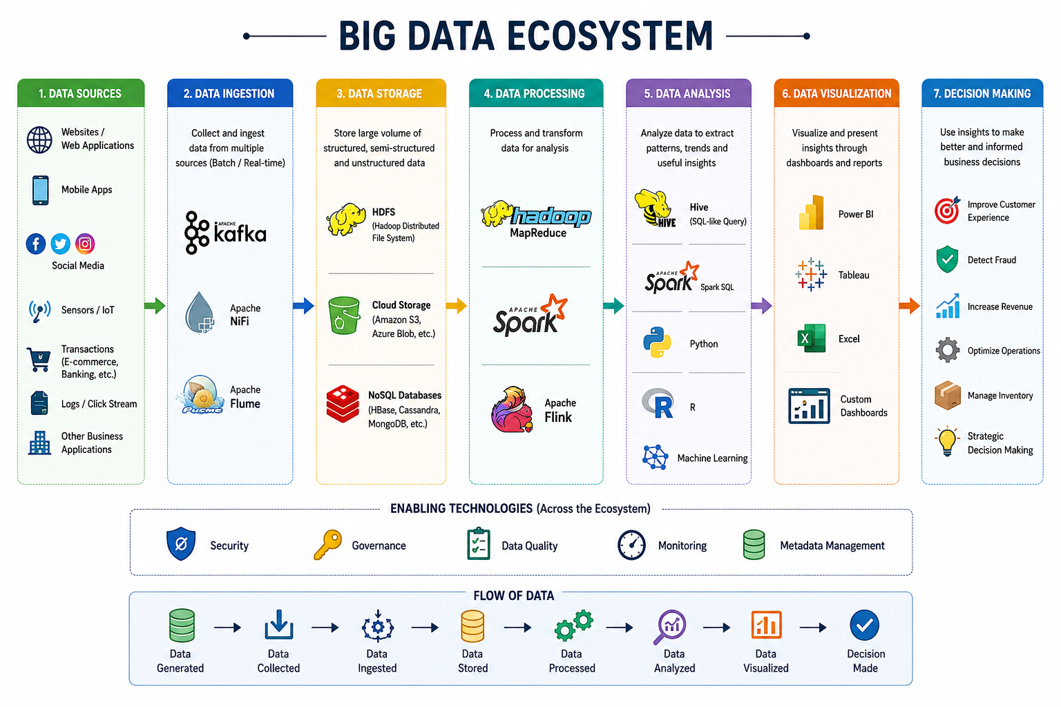

Slide 93
Layer 1 — Data Sources
Data Sources are the places or systems from which data is generated.
In simple words:
Data Sources = Where does the data come from?
Before doing anything with Big Data, we need data.
Examples of Data Sources
Data can come from:
Websites
Mobile applications
Social media
Sensors
IoT devices
Banking systems
E-commerce transactions
GPS devices
Application logs
E-commerce Example
Suppose a customer opens an online shopping app.
The customer:
Searches for a laptop
↓
Views a product
↓
Adds it to cart
↓
Makes payment
↓
Writes a review
Every activity generates data.
So, the website and mobile application are data sources.

Slide 94
Layer 2 — Data Ingestion
“We have data coming from websites, mobile apps, sensors, and other sources. How do we bring all this data into our Big Data system?”
Answer:
Data Ingestion.
Data ingestion is the process of collecting and transferring data from different sources into a system for storage and processing.
In simple words:
Data Ingestion = Bringing data into the Big Data system.
Example
Website ───────┐
Mobile App ────┤
Sensors ───────┤
Social Media ──┤
Transactions ──┘
↓
Data Ingestion
↓
Big Data System
Tools
Common tools include:
Apache Kafka
Apache NiFi
Apache Flume

Slide 95
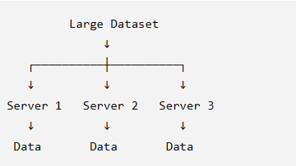
Layer 3 — Data Storage
“After collecting all this data, where do we keep it?”
Answer:
Data Storage.
Data storage is the process of storing large amounts of data so that it can be accessed and processed when required.
In simple words:
Data Storage = Where do we keep the data?
Examples
HDFS
Cloud storage
Amazon S3
NoSQL databases
Data lakes
HDFS Example
HDFS stands for:
Hadoop Distributed File System
It stores large datasets across multiple machines.
This is called distributed storage.

Slide 96
Layer 4 — Data Processing
“We have stored billions of records. Can we directly analyze all this raw data?”
Usually, we first need to process and transform it.
Data processing is the process of transforming raw data into a useful and organized form for analysis.
In simple words:
Data Processing = Convert raw data into usable data.
Example
Suppose we have raw transactions:
Order 101 → Laptop → ₹50,000
Order 102 → Phone → ₹30,000
Order 103 → Laptop → ₹50,000
Order 104 → Tablet → ₹20,000
Processing can help us calculate:
Laptop → 2 orders
Phone → 1 order
Tablet → 1 order
We can also:
Remove duplicate records
Handle missing values
Convert data formats
Filter unwanted data
Aggregate data
Calculate totals and averages
Tools
Major tools include:
Hadoop MapReduce
Apache Spark
Apache Flink

Slide 97
Layer 5 — Data Analysis
After processing the data,
“What can we learn from this data?”
This is Data Analysis.
Data analysis is the process of examining processed data to identify patterns, trends, relationships, and useful information.
In simple words:
Data Analysis = Find useful information from the data.
E-commerce Example
The company may ask:
Which product sells the most?
Which region has the highest sales?
Which customers purchase frequently?
Which products are often purchased together?
Which month has the highest sales?
Suppose the analysis shows:
Laptop
↓
Highest-selling product
The company now has useful information.
Tools
SQL
Hive
Spark SQL
Python
R
Machine Learning

Slide 98
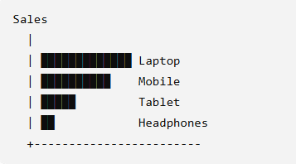
Layer 6 — Data Visualization
“We have found useful information. How can we show it to managers or users in an easy-to-understand way?”
Answer:
Data Visualization.
Data visualization is the graphical representation of data using charts, graphs, dashboards, and other visual formats.
In simple words:
Data Visualization = Show data in a visual and understandable form.
Example
Suppose analysis gives:
Laptop ₹50,00,000
Mobile ₹40,00,000
Tablet ₹20,00,000
Headphones ₹10,00,000
Instead of giving the manager a large table, we can create a bar chart:
Tools
Power BI
Tableau
Python
Excel
Now it is easy to identify the best-selling category.

Slide 99
Layer 7 — Decision Making
This is the final objective.
“Why did we collect, store, process, and analyze all this data?”
Answer:
To make better decisions.
Decision making is the process of using insights obtained from data to make informed business or operational decisions.
In simple words:
Decision Making = Use the information to decide what to do next.
E-commerce Example
Analysis shows:
Laptop sales are increasing
↓
Company gets the insight
↓
Decision:
Increase laptop inventory
↓
Run laptop promotions
If data shows that laptop demand is increasing, the company can increase inventory and promotional activities.

Slide 100
END OF MODULE -01

